Slide 1
Data Science Engineering Methods and Tools Lecture 8
Northeastern University
College of Engineering
Multidisciplinary Graduate Engineering Department
INFO 6105 – Fall 2024
Instructor: Abdolreza Mosaddegh

Slide 2
Curse-of-Dimensionality
Typically, most of datasets are high in dimensions (features)
In high dimensional data, distances between data points get larger.
Without many instances (proportional to number of features), distance measure becomes less reliable
Prediction accuracy can quickly degrade when number of attributes grows.
Increasing the number of features will not always improve classification accuracy.

Slide 3
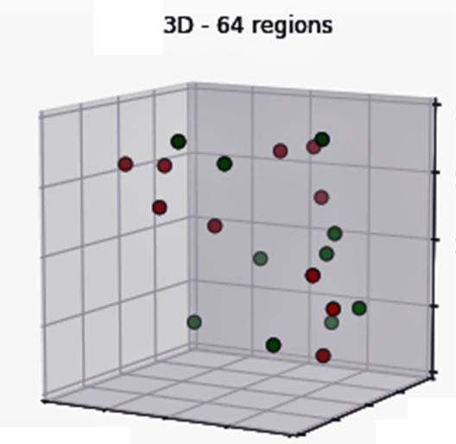
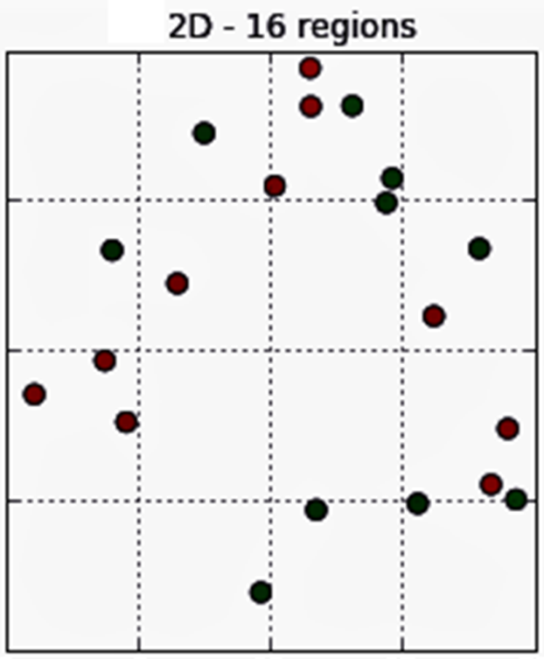
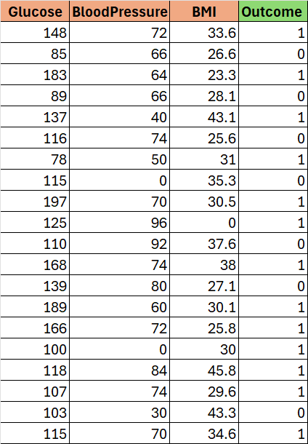
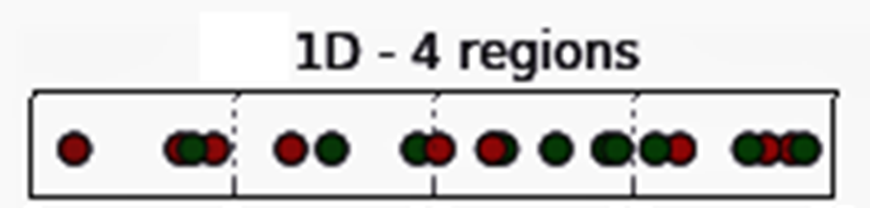
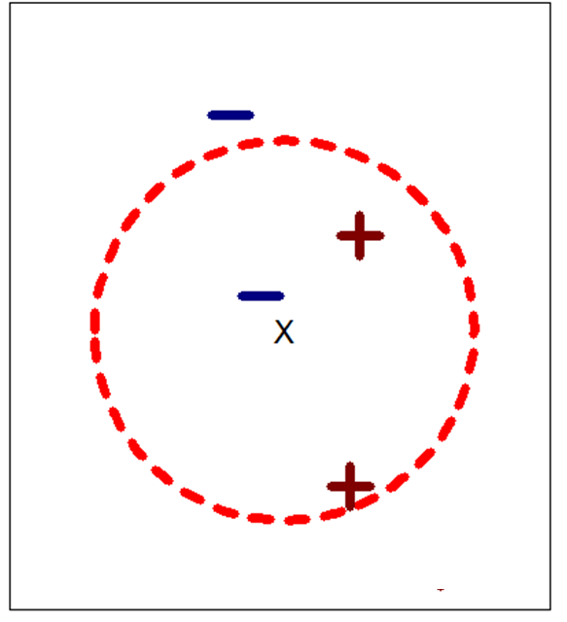
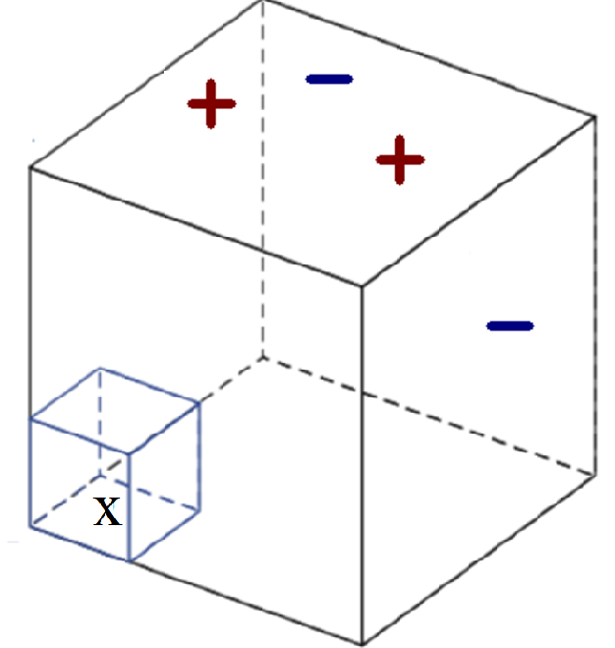
Curse-of-Dimensionality - Example
20 data points
As dimensionality grows: fewer observations per region and less reliable results

Slide 4
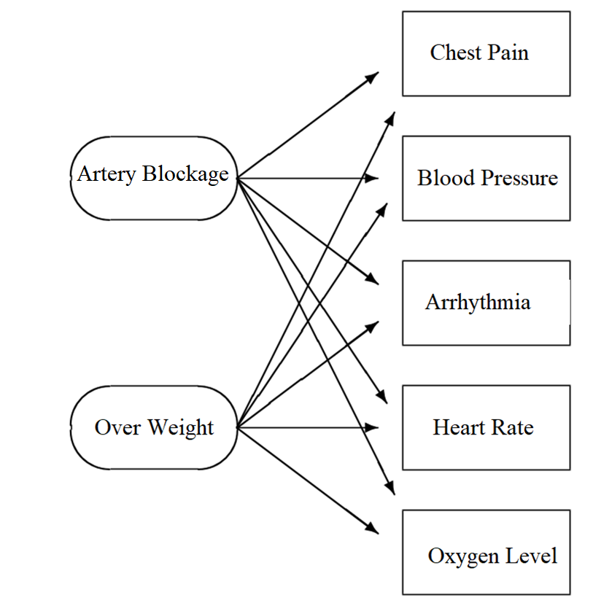
Solution: Dimensionality Reduction
Reduce the number of input variables (features):
Avoid curse of dimensionality
Remove features which are irrelevant for prediction / classification
Intrinsic dimensionality may be smaller than the number of features (some hidden variables can represent many observer variables)
Avoid overfitting: in some datasets there is a weak correlation between some features with the class that is not general
To visualize high dimensional data
Reducing computational costs

Slide 5
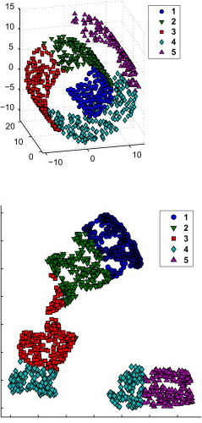
Problem Statement
Objective:
Choose an optimum set of features with a lower dimensionality to improve classification accuracy (classification-driven) → e.g., To Avoid C.D.
Choose an optimum set of features with a lower dimensionality represent original features efficiently (information-driven) → e.g., For Visualization
d*

Slide 6
Dimensionality Reduction Methods
Feature extraction:
creates a new set of features from the original features through some transformation .
Feature selection: chooses a subset of the original features.
Transformation could be linear or non-linear
K<D
Linear transformations are particularly attractive because they are analytically tractable.

Slide 7
Feature Selection Advantages
FS provides more interpretable features
Transform features creates new variables with unknown meaning which is not easy to interpret. This is more important in white-box models.
Features may not be numeric
Sometimes it is difficult to convert nominal variables to new features

Slide 8
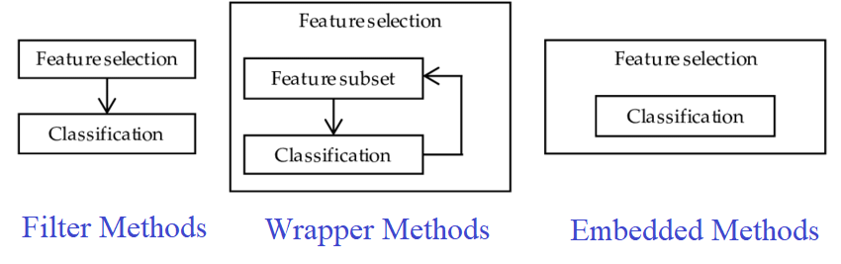
Feature Selection
Feature selection is an optimization problem (optimizing objective function)
The objective function is a criterion that evaluates the quality of a feature subset
There are three main evaluation strategies for feature Selection:
Filter methods
Wrapper methods
Embedded methods
Note: Feature selection can also be done by knowledge of subject matter experts.

Slide 9
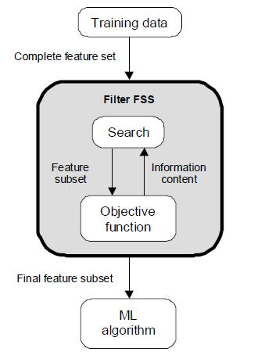
Evaluation Strategies – Filter Methods
Filters work independent of any particular learning algorithm (scores of features are independent of the ML model )
Filters seek a subset of features which maximize objective function (e.g., information content, dependence, etc.)
Filter method can score a subset of features together
Usually try to find the smallest size where adding more features does not yield improvement. Sometimes number of features is predefined by user

Slide 10
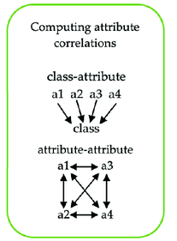
Selection Criteria
High correlation with the output variable (objective function based on dependence measures)
Low correlation with other independent variables (objective function based on dependence measures)
More informative (objective function based on information content)
Correlation-based Feature Selection (CFS) is a feature selection technique that selects subsets of features that are highly correlated with the target variable but have low correlation with each other.

Slide 11
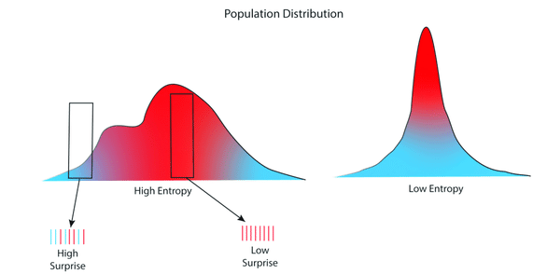
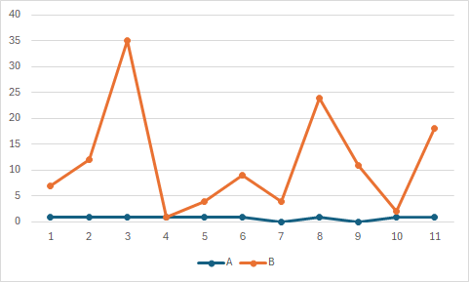
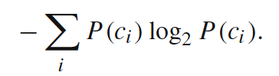
Objective Function – Information Content
Information Measures measure information content of variables:
Variance threshold: to remove any features that have little variation in their values (below the threshold)
Shannon’s Entropy: the entropy of a variable is the average level of "information", or "surprise" inherent to the variable's possible outcomes
Shannon’s Entropy=
Low Variance vs High Variance Features

Slide 12
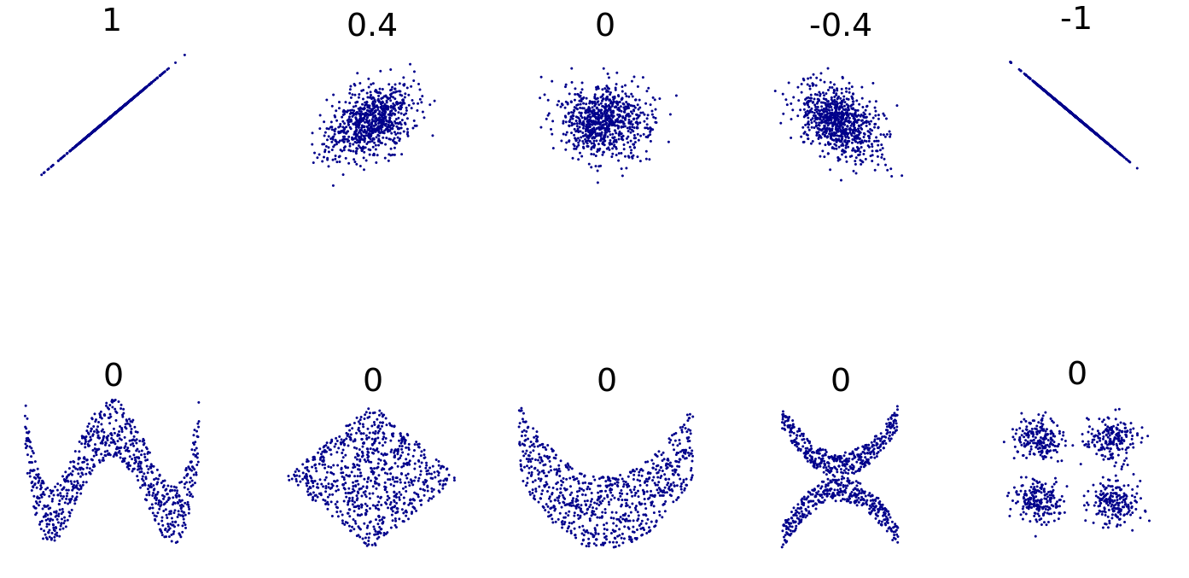
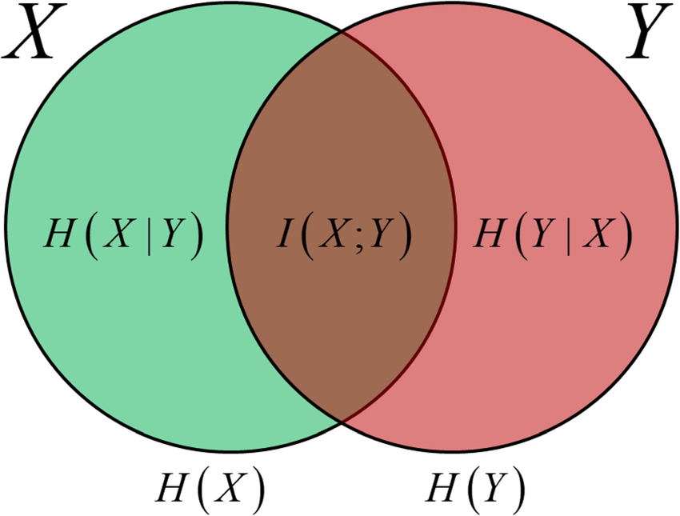
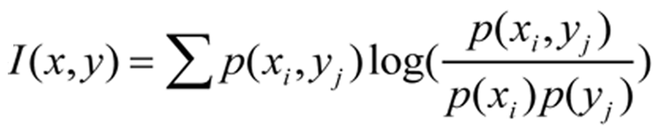
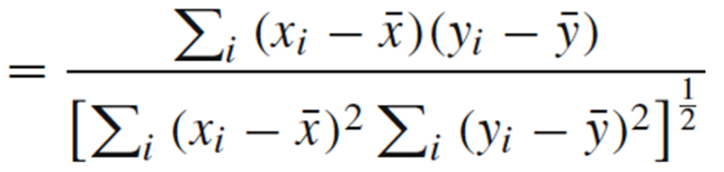
Objective Functions – Dependence
Dependence Measures measure relationship between variables:
Pearson’s correlation coefficient (linear relationship ), chi-square (categorical variables), mutual information (dependence and information), etc.
mutual information
Pearson correlation coefficient

Slide 13
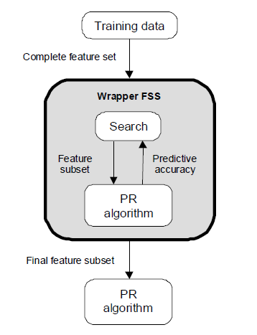
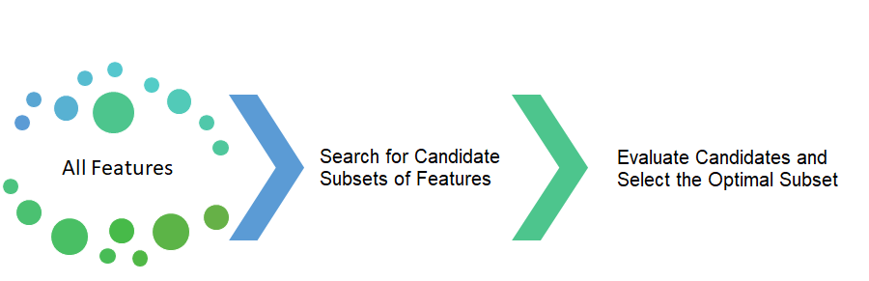
Evaluation Strategies– Wrapper Methods
Optimizes for a specific learning algorithm
Wrappers seek a subset of features which maximize classification / regression accuracy (or other objective functions)
There are two main steps for wrapper methods:
Search the space of possible feature subsets and select candidate subsets.
Evaluate each candidate subset with respect to certain criteria and pick the optimal subset

Slide 14
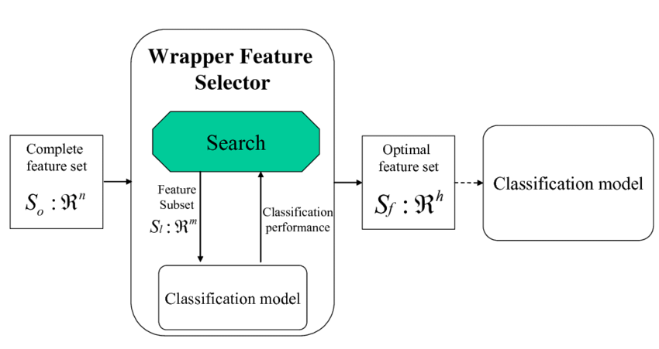
Evaluation Strategies– Wrapper Methods
The feature selection is a wrapper around the learning algorithm
Select a few subsets of features (Candidate Subset Selection)
Create training/validation sets based on each feature subset
Train the learning algorithm with each training set
Find accuracy (or other objective) with each validation set
Pick the feature subset with the highest accuracy (or other objective)
Two Requirements of Wrapper Method:
Method of Candidate Subset Selection (Search Strategy)
Objective Function (Selection Criteria )

Slide 15
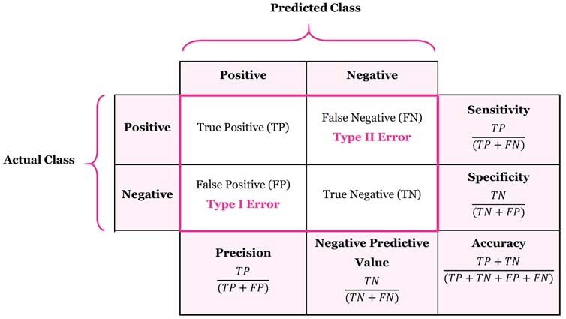
Objective Function
Accuracy Measures:
Selection of accuracy measures rely on the application and ML algorithm

Slide 16
Candidate Subset Selection - Naïve Search
Use each individual feature for classification.
Sort the features ordered by accuracy (or other objectives) of classification.
Select the top M features from this sorted list.
Advantage
Fast
Disadvantage
Best set of features may not be the set of best individual features.
Correlations between features are not considered.
Features: x₁, x₂, x₃, x₄
Rank of individual features by classification accuracy
x₄ , x₂ , x₃ , x₁

Slide 17
Search Strategies - Exhaustive Search
Exhaustive search generates all 2^{n} possible subset of n features
Each of these subsets should be used for training the model to be evaluated by the objective function
This evaluation is computationally expensive if many features exists in the dataset, since it needs training process
In such cases, it is more practical to use heuristic approaches
Sometimes the results of heuristic approaches is not globally optimum .
Example of Four Features – x₁, x₂, x₃, x₄
1,1,1,1
0,1,1,1
1,0,1,1
1,1,0,1
1,1,1,0
0,1,0,1
0,1,0,1
1,0,0,1
0,1,1,0
1,0,1,0
1,1,0,0
0,0,0,1
0,0,1,0
0,1,0,0
1,0,0,0
0,0,0,0
1-x_{i} is selected; 0-x_{i} is not selected

Slide 18
Search Strategies - Heuristic and Random Methods
Sequential Forward Generation (SFG)- Greedy
Start from an empty set and add a feature with best score (based on objective function)
Calculate score of each subset consisting of the current subset plus one remaining feature and select the subset with the best score (add feature causing most increase in accuracy)
Continue until there is no significant improvement or reaching desired number of features
Sequential Backward Generation (SBG) - Greedy
Start from a complete set of features
T Calculate score of each subset consisting of the current subset minus one of it’s features and select the subset with the best score (remove feature causing least decrease in accuracy)
Continue until dropping any feature causes a significant decreases in accuracy (or enough features)
Bidirectional Generation (BG) – Greedy
Begins the search in both directions, performing SFG and SBG concurrently
Stop when one search finds the best subset or both searches achieve the middle
4) Random Generation (RG)
The choice of adding or removing a features is a random decision.
RG tries to avoid the stagnation into a local optimal set

Slide 19
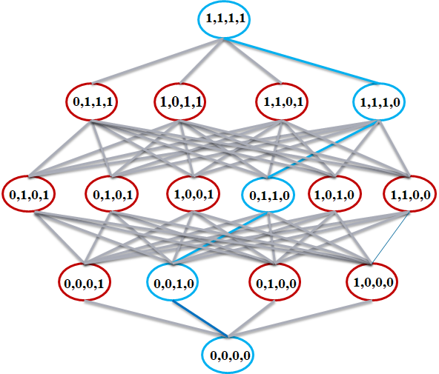
Forward Selection - Example
{x₁, x₂, x₃, x₄}
Stops if improvement is not significant
{x₂ , x₃ , x₁}
{x₂ , x₃, x₄}
J(x₂, x₃ , x₁)>=J(x₂, x₃, x₄)
J(x₂, x₃ , x₁) >> J(x₂, x₃) ?
{x₂, x₁}
{x₂ , x₃}
{x₂ , x₄}
J(x₂, x₃)>=J(x₂, x_{i}); i=1,4
J(x₂, x₃) >> J(x2) ?
{x₁} {x₂} {x₃} {x₄}
J(x₂)>=J(x_{i}); i=1,3,4
J: Objective Function
(e.g., Accuracy of the classifier)

Slide 20
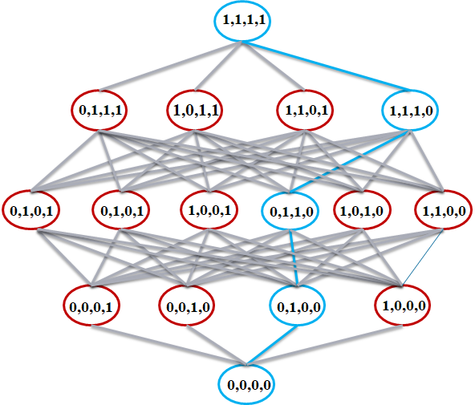
Backward Selection - Example
{x₁, x₂, x₃, x₄}
J: Objective Function
{x₂, x₃, x₄}
{x₁, x₃, x₄}
{x₁, x₂, x₄}
{x₁, x₂, x₃}
J(x₁, x₂, x₃) is maximum
J(x_{1,} x₂, x₃) ≈ J(x_{1,} x₂, x_{3,} x₄) ?
{x₂, x₃}
{x₁, x₃}
{x₁, x₂}
J(x₂, x₃) is maximum
J(x₂, x₃) ≈ J(x_{1,} x₂, x₃) ?
{x₂} {x₃}
J(x₂) is maximum
J(x₂) ≈ J(x₂, x₃) ?

Slide 21
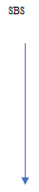
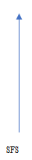
Bidirectional Selection - Example
J: Objective Function
{x₁, x₂, x₃, x₄}
Step2:
Consider all subset containing x2:
J(x₂, x₁, x₄) is maximum
x₃ is removed
{x₂, x₃, x₄}
{x₂, x₁, x₄}
{x₂, x₁, x₃}
Step 3:
Consider all subset without x3:
J(x₂, x₄) is maximum
x₄ is selected
Step 4:
Consider all subset containing x2 , x4:
Only (x₂, x₄) can be selected
{x₂, x₁}
{x₂, x₄}
Step 1:
J(x₂) is maximum
x₂ is selected
{x₁}
{x₂}
{x₃}
{x₄}

Slide 22
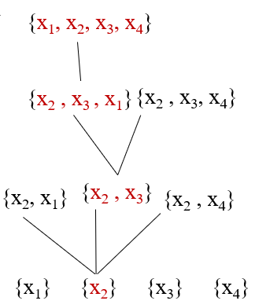
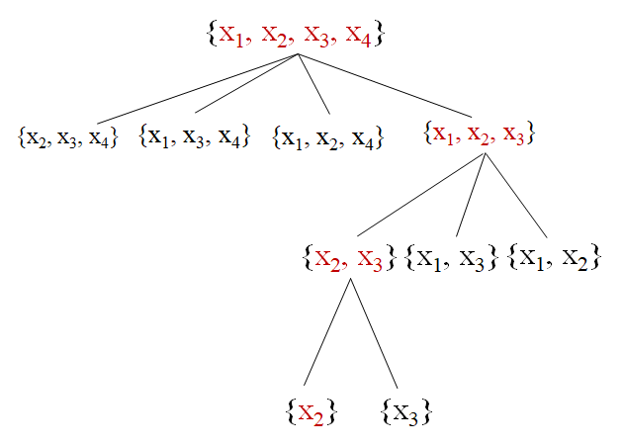
Heuristic Search Strategies Comparison
These algorithm are greedy; therefore, the results are locally optimum but not necessarily globally optimum.
Forward sequential selection is faster than backward sequential selection since it starts from smaller sets and doesn’t check most feature sets with large number of variables.
Backward sequential selection is more accurate than forward sequential selection since it checks more larger combinations of features.
Bidirectional sequential selection is more flexible than the other two techniques, but it can be more complex.

Slide 23
Filter vs Wrapper
Filter Approach
Advantages
Fast execution: Filters generally involve a non-iterative computation on the dataset, which can execute much faster than a classifier training session
Generality: Since filters evaluate the intrinsic properties of the data, rather than their interactions with a particular classifier, their results exhibit more generality and will be good for a large family of classifiers
Disadvantages
Tendency to select large subsets: Filter objective functions are generally monotonic
Wrapper Approach
Advantages
Accuracy: wrappers generally have better recognition rates than filters since they tuned to the specific interactions between the classifier and the features.
Avoid overfitting : use internal mechanism of the ML algorithm to control the overfitting.
Disadvantages
Slow execution

Slide 24
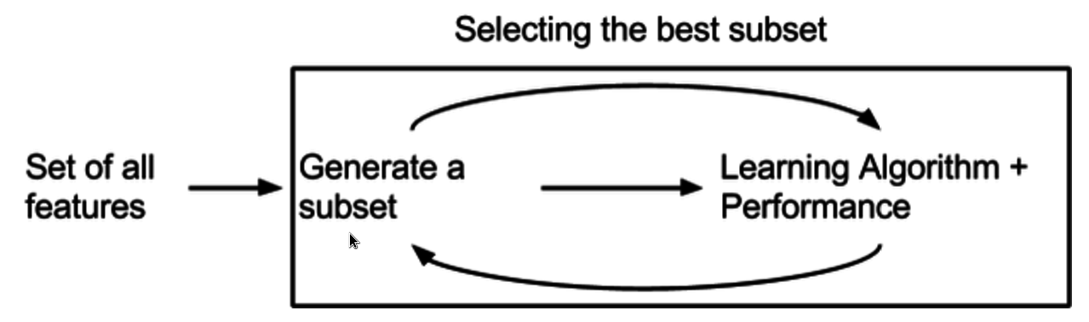
Evaluation Strategies – Embedded Methods
Embedded methods embed the selection procedure in the training of the predictive model (e.g. Random forest)
The features are selected during the learning process.
Similar to the wrapper approach features are specifically selected for a certain learning algorithm
Achieve a faster solution by avoiding the re-training of a predictor for each feature subset explored.

Slide 25
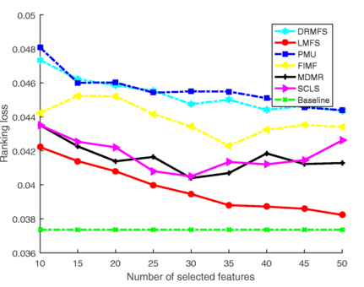
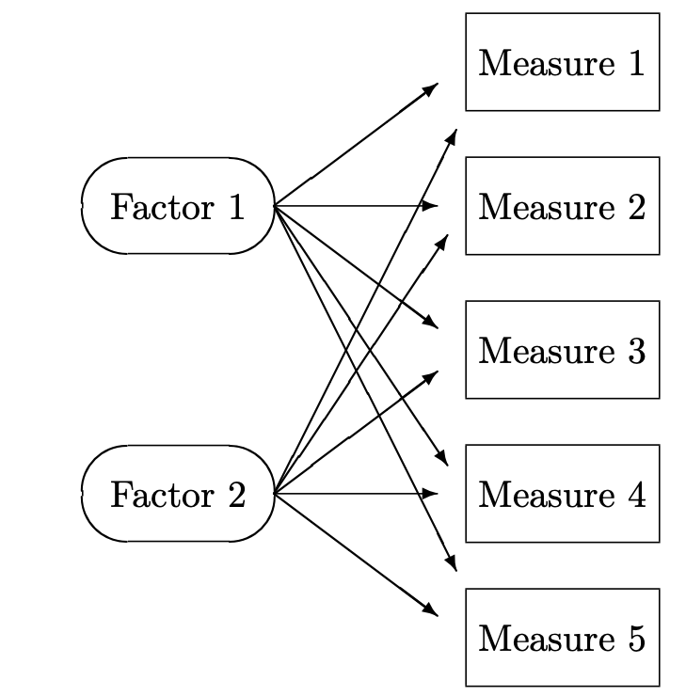
Feature Selection Drawbacks
It is not true that a large dimensionality input can always be reduced to a small subset of features
Sometimes the objective function is actually related with many input features and the removal of any of them will seriously effect the learning performance.
Possible hidden variables which represent some feature variables cannot be recognized in feature selection methods
Ranking loss comparison of different feature selection methods when ML-KNN is used as the basic classifier (Yao Zhang, 2022)

Slide 26
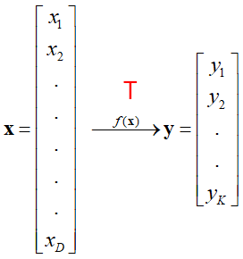
Feature Extraction
FE is a transformation(mapping) from D dimensions to K dimensions
Finding an optimum mapping can be formulated as an optimization problem (i.e., minimize or maximize an objective function).
Popular linear feature extraction methods:
Principal Components Analysis (PCA): Seeks a projection that minimizes information loss.
Linear Discriminant Analysis (LDA): Seeks a projection that maximizes class separability.
Many other methods:
Making features as independent as possible (Independent Component Analysis).
Retaining interesting directions (Projection Pursuit).
Embedding to lower dimensional manifolds (Isomap, Locally Linear Embedding).
Etc.

Slide 27
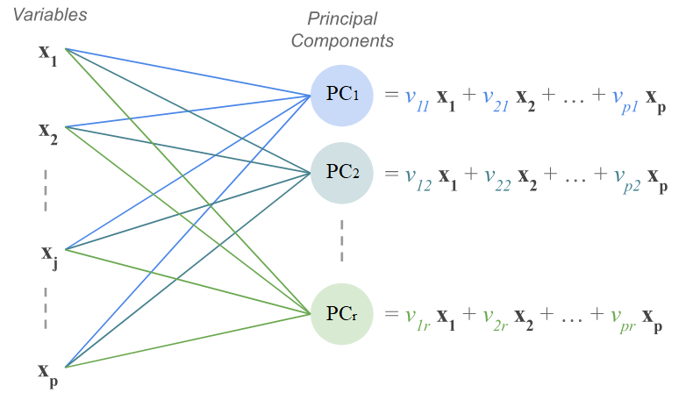
Principal Component Analysis
Unsupervised approach creates new variables (principal components) from existing variables.
Principal components are a few linear combinations of the original variables that maximally explain the variance of all the variables.
The new variables (components):
Capture as much of the original variance in the data as possible
Are linear combinations of the original ones
Are uncorrelated with one another
Are called Principal Components

Slide 28
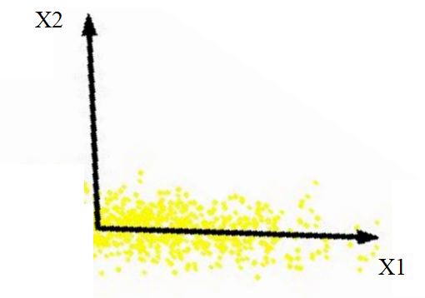
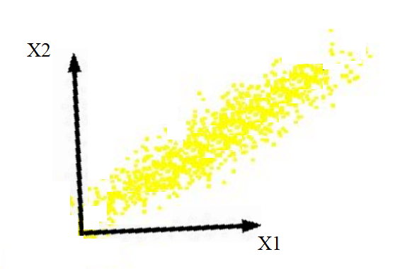
PCA – Idea
Most information (variability) is explained by X1
Information (variability) is explained by both X1 and X2
There is no correlation between x1 , x2
There is a correlation between x1 , x2
Intrinsically lower dimensional.
We can remove X2 without loosing many information (a good candidate for dimensionality reduction)
Removing X1 or X2 cause a main information loss
(Not a good candidate for dimensionality reduction)

Slide 29
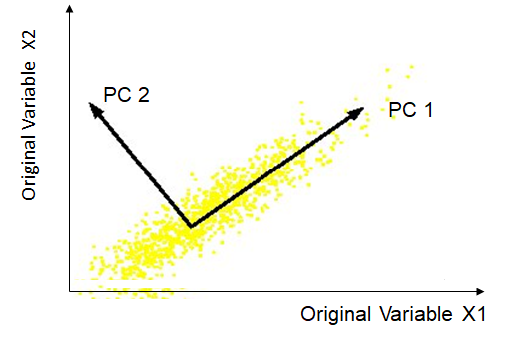
PCA - New Dimensions
Idea : Using correlations between two features, define a new variable (component) contains most of information (variability)
Both features contain some part of information (Variability)
Only one of new features (components) contains most of information (Variability)
There is a linear correlation between X1, X2
PC1 is aligned with the direction of covariance between x1,x2

Slide 30
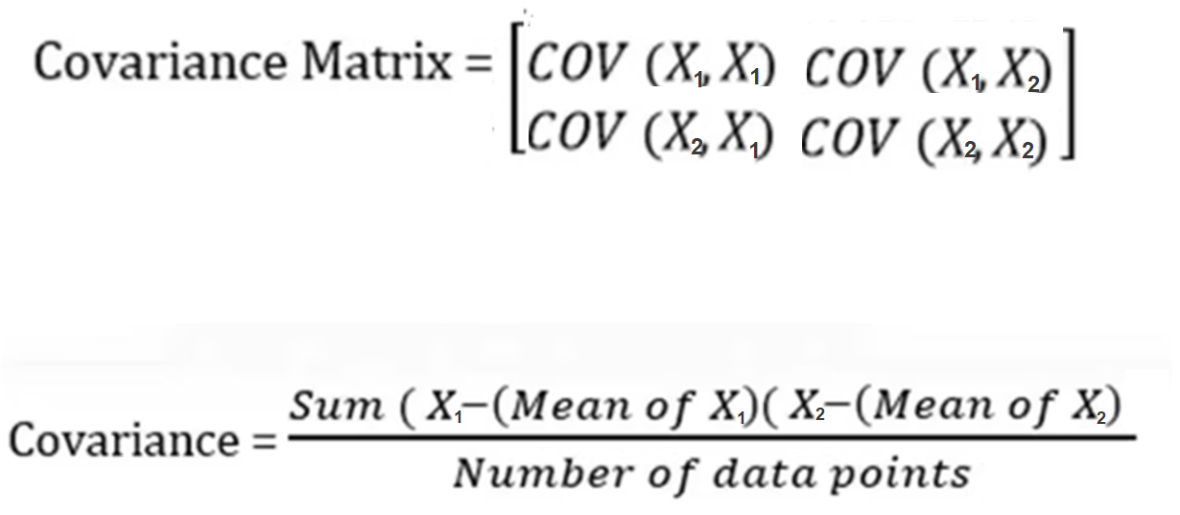
Covariance Matrix
Covariance measures how two dimensions (features) vary with respect to each other. It shows the linear relationship between two variables.
Normalize data features so they have similar magnitudes else covariance may not be as informative
We can use covariance matrix to find new dimensions.
x2
x1

Slide 31
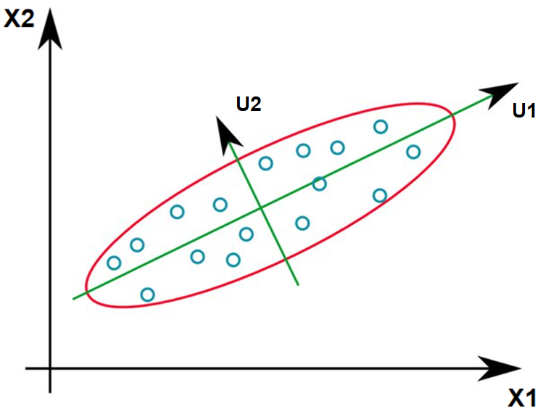
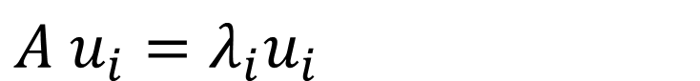
Eigenvectors of Covariance Matrix
Eigenvectors of covariance matrix signify the orientation of the new dimensions
Eigenvalues represent the amount of variance the new dimensions explains.
PCA projects the data into new dimensions (Eigenvectors).
$$A{ u}_{i}=λ_{i}u_{i}$$
A is covariance Matrix
ui are eigenvectors of A
u1: direction of max variance
u2: orthogonal to u

Slide 32
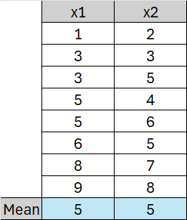
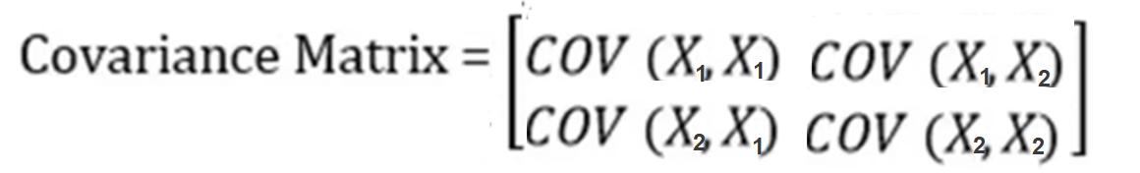
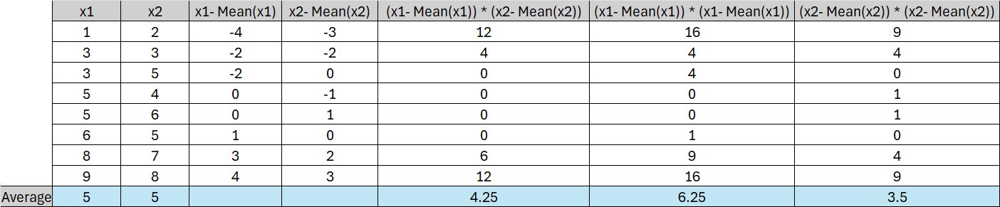
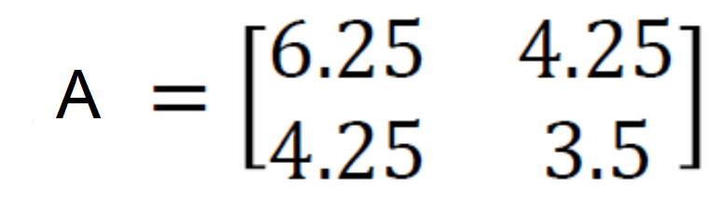
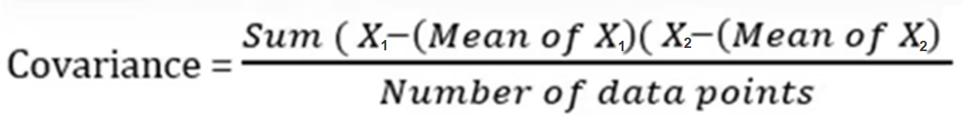
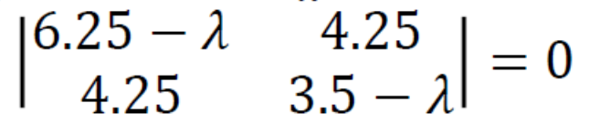
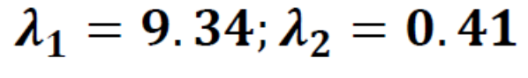
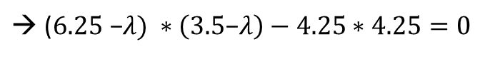
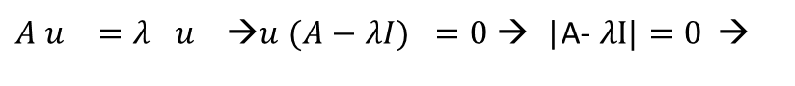
Eigenvectors of Covariance Matrix - Example
Compute the Eigen Vector of the following dataset:
Covariance matrix:
The eigenvalues can be computed by finding the roots of the characteristic polynomial:
$A u_{}=λ_{}u_{} \text{→}u (A {− λI)}_{}=0$ → |A- $λI|=0 \text{→}$
$\text{→}$ ($6.25\text{ −}λ) ∗\left(3.5\text{−}λ\right)−4.25∗4.25=0$
$$→$$

Slide 33
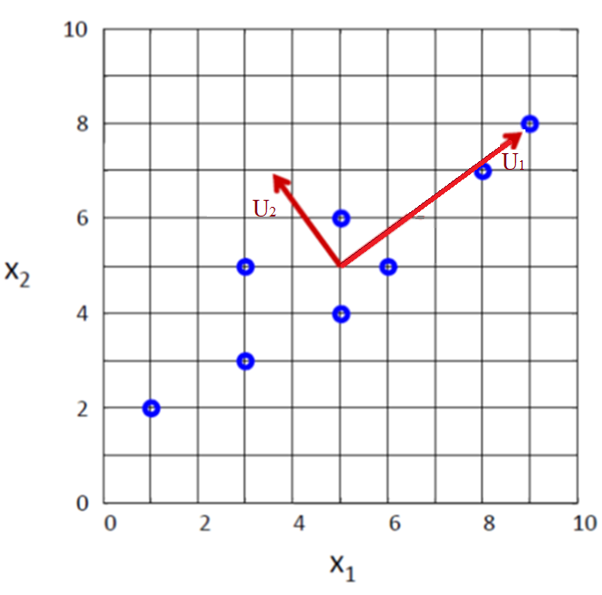
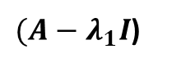








Eigenvectors of Covariance Matrix - Example
The eigenvectors are the solutions of:
Eigenvectors are typically normalized to have unit-length
$A u_{i }=λ_{i}u_{i }→u_{i }(A−$ $λ_{i}I$) = 0
$$u_{1 }$$
$(A−$ $λ_{1}I$)
$${ −3.09 u}_{11 }+{ 4.25 u}_{12 }=0$$
$${4.25u}_{11 }−{ 5.84 u}_{12 }=0$$
${ \sqrt{{ u}_{11 }2+{ u}_{12 }2}}_{}=1$
6.25-9.34 | 4.25
4.25 | 3.5-9.34
u11
u12
0
0
$$→$$
$$→u_{1= }$$
0.81
0.59
*
=
$$u_{2 }$$
$(A−$ $λ_{2}I$)
$${5.84 u}_{21 }+{ 4.25 u}_{22 }=0$$
$${4.25u}_{21 }+{ 3.09 u}_{22 }=0$$
$${ \sqrt{{ u}_{21 }2+{ u}_{22 }2}}_{}=1$$
6.25–0.41 | 4.25
4.25 | 3.5- 0.41
*
u21
u22
=
0
0
$$→$$
$${→u}_{2= }$$
-0.59
0.81

Slide 34

PCA Algorithm Steps
Center and normalize features
Calculate the covariance matrix of the centered features
Calculate the unit eigenvectors and eigenvalues of the covariance matrix
Keep p (< original dimensions) eigenvectors with the largest eigenvalues
Matrix multiply the p eigenvectors with the centered data to transform data to only p features
Number of PCs is equal to number of original features
But first PC will be most informative and second one will be the second most informative and so on…

Slide 35

PCA Example – Psychoneurosis Symptoms
Symptom Scores ( from 1 to 7)
Patient 1
Patient 2
Patient 3
Patient 4
Patient 5

Slide 36




PCA Example – Normalizing

Slide 37

PCA Example – Covariance Matrix
COV(F1,F2) = ((-1.0695–0)(0.8196-0) +
(0.5347–0)(-1.6393-0) +
(-1.0695–0)* (0.0000-0) +
(0.5347–0)(0.0000-0)+
(1.0695–0)(0.8196–0)) / 5
= -0.8586

Slide 38

PCA Example – Calculation of Eigen Values
det(A- λI) = 0
A- λI =
det(A- λI) = 0 → λ = 2.11691 , 0.855413 , 0.481689 , 0.334007
Larger Eigen Values indicates more coverage of variance

Slide 39

PCA Example – Calculating Eigen Vectors
Av = λv → (A-λI)ν=0
λ = 2.11691 , 0.855413 , 0.481689 , 0.334007 (ordered)
For λ = 2.11691, the eigen vector is:
0.515514
-0.616625
0.399314
0.441098
Regarding λ we select
E1 and E2 which explain most variances
Most Important Component
Second Important Component

Slide 40



PCA Example – Transform to New Features
Transformed Dataset = Normalized Dataset * Selected_eigenvectors
PC1 PC2
=

Slide 41
PCA Example – Interpretation of PCs
Original Data
Eigen Vectors
E1->PC1 E2->PC2
F1
F2
F3
F4
PC1 = Highly correlated directly with F1,F2,F3 and indirectly with F4 → Autism ?
PC2 = Highly correlated directly with F1 and indirectly with F4 → ADHD ?

Slide 42

PCA vs Factor Analysis
Factor analysis explicitly assumes the existence of hidden factors underlying the observed data.
PCA seeks to create variables that are composites of the observed variables.
Although the techniques can get different results, however, In most cases PCA is used for conducting factor analysis
Sometimes, PCs are difficult to interpret due to black-box nature of PCA

Slide 43
Optimal Number of Selected PCs
Number of components is the same as number of variables but the first ones have most of the information
First m components (with most information) can be selected as new features
Three best practices:
the visual examination of a scree plot
the variance explained criteria
the Kaiser rule

Slide 44

The Visual Examination
First 2 PCs covered 87% of variability

Slide 45

Variance Criteria
The variance explained criteria:
set a threshold (e.g., 90%) and stop when the first k components account for a percentage of total variation greater than this threshold
Kaiser’s rule (Kaiser-Guttman criterion):
principal components are retained, whose eigenvalue exceed 1.
The idea behind the Kaiser-Guttman criterion is that any principal with variance less than 1 contains less information than one of the original variables and so is not worth retaining.
However, sometimes the aggregated variance covered by PCs is also important. In such cases, variance threshold is a better choice.
λ = 2.11691 , 0.855413 , 0.481689 , 0.334007

Slide 46

PCA Application in Images Processing
Goal: represent images in a space of lower dimensionality using PCA.
Useful for various applications, e.g., face recognition, image compression, etc.
Interpretation: approximate a face image using K largest eigenvectors (Eigenfaces)
K largest eigenvectors
Eigenfaces are the eigenvectors of the covariance matrix of a set of face images
y₁
y₂
y₃
When properly weighted, eigenfaces can be summed together to create an approximate gray-scale rendering of a human face.

Slide 47

PCA Limitations
PCA is not always an optimal dimensionality-reduction technique for classification purposes.
Best class distinction
Best Variability

Slide 48

Linear Discriminant Analysis (LDA)
A supervised technique seeks to find linear transformation which the classes are best separated (i.e., find more discriminatory features).
projection direction
projection direction
Bad separability
Good separability

Slide 49




LDA - Method
LDA transforms features to a space which maximizes their between-class separability while minimizing their within-class variability.
The main objective of LDA is to find a transformation (projection) that maximises the ratio of the determinant of S_{b} to the determinant of S_{w} (Fisher’s criterion) :
Using the following equation, we can find eigen vectors of u which are columns of transformation matrix:
Good Transformation Bad Transformation

Slide 50
LDA Steps
Compute the mean vectors.
Compute the scatter matrices (Sb, Sw)
Compute the eigenvectors and corresponding eigenvalues for the following equation:
Sort the eigenvalues and choose those eigenvectors with the largest eigenvalues to form a transformation matrix
Transform the data onto the new subspace.

Slide 51

PCA vs LDA
LDA is more effective than PCA for classification
PCA is more effective than LDA for preserving information
LDA is supervised; Therefore, we need labels to use LDA
PCA is unsupervised and can be used without labels

Slide 52

Assignment 8
Use world_ds.csv dataset containing socio-economic variables (features) of different countries and corresponding development_status as outcome (label).
Employ forward wrapper method to select best three features from the dataset.
Use a PCA model to create 3 new components from existing features.
Explain each PC (new features) based on the correlations with old features.
Use a LDA model to create 2 new components from existing features.
Compare the accuracy of a KNN classifier on new or selected features resulting by forward, PCA and LDA.

